Slide 1
Course 3 Capstone
Data Collection

Slide 2
Finding the Middle
Mean, Median, and Mode help you compare data. Below, list the mean, median, and mode of the clicks in the provided data.
Mean: 5.980821918
Median: 6
Mode: 5

Slide 3
Finding the Middle
Mean, Median, and Mode help you compare data. Below, list the mean, median, and mode of the conversions in the provided data.
Mean: 60.38356164
Median: 60
Mode: 78

Slide 4
Standard Deviation
Determining variance in data helps you [why this is helpful]. Below, enter the standard deviation of the provided data.
Standard Deviation of Clicks: 1.62810629
Standard Deviation of Conversions: 14.36822476

Slide 5
Frequency and Contingency Tables
Understanding how often something happens is important to understanding trends and patterns in your data. Create and insert a contingency table generated from your data.
number of conversions | 1 a 5 | 6a10 | 11 a 15 | 16
number of occurrences | 1 | 128 | 189 | 47

Slide 6
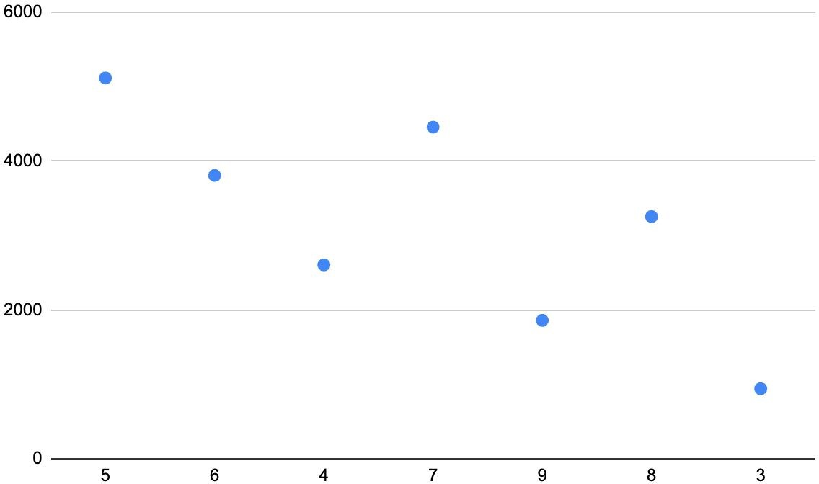
Scatter Plot
Understanding the
relationships between data is important to understanding trends and
patterns. Create and insert a scatter plot generated from your data. Then, include the input the correlation coefﬁcient as well.
Scatter Plot of your data:
Correlation coefﬁcient: 0.79

Slide 7
End of Section 1

Slide 8
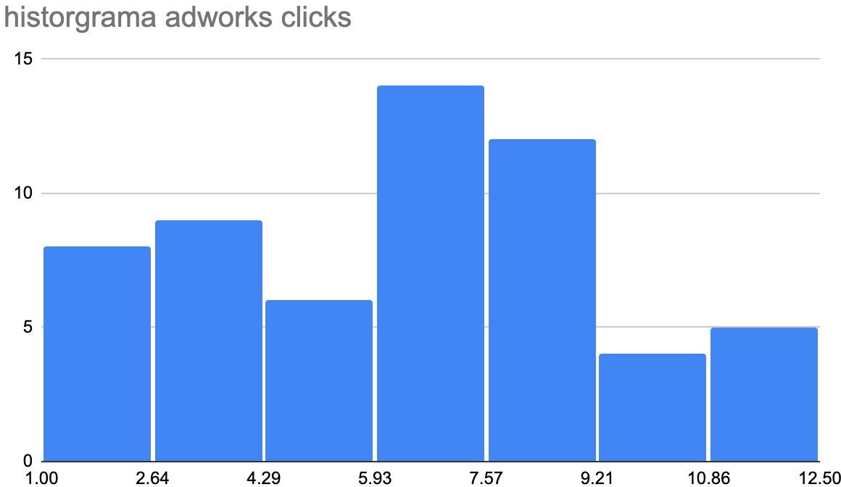
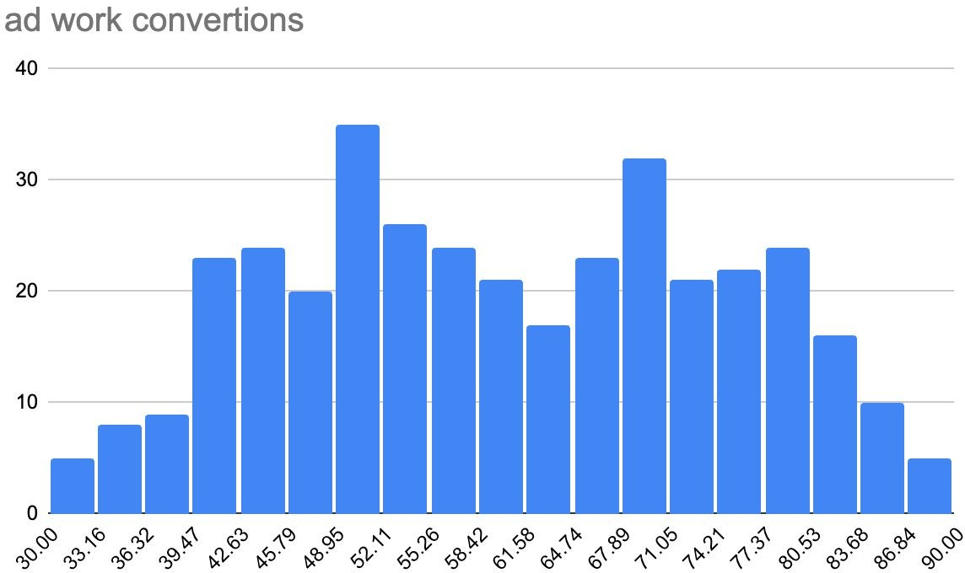
Sample Type
It’s important to understand the sample you’re using in your analysis. Fill in the information below about the sample you have received:
Histogram of your clicks data: Histogram of conversions data:

Slide 9
Sample Type
It’s important to understand the sample you’re using in your analysis. Fill in the
information below about the sample you have received:
Does the clicks data have a normal distribution? no
Does the conversions data have a normal distribution? Yes

Slide 10
Variable Types
Determining the types of variables your working with is an important skill. Below, list the variables from your data that are:
Quantitative:
Continuous: ad work clicks Discrete: Number of clicks
Qualitative:
Nominal: ad work convertions Ordinal: Number of clicks

Slide 11
End of Section 2

Slide 12
Question and Hypothesis
The question you hope to answer and your hypothesized answer are necessary to complete an analysis. Answer the following questions
What is your hypothesis based off the evaluation question? Do ad conversions go or depend on the number of clicks?

Slide 13
Question and Hypothesis
The question you hope to answer and your hypothesized answer are necessary to
complete an analysis. Answer the following questions
What is your independent variable? Number of Clicks
What is your dependent variable? Advertisements

Slide 14
Running a Test
With your question and hypothesis ready, run the test on the two sets of data. Fill in the
information below.
Mean number of Facebook conversions: 46.68
Mean number of Adware conversions: 62.13 p-Value: 4.3

Slide 15
Hypothesis
After running the test, was your hypothesis proven correct?
Do your ﬁndings support a null or an alternative hypothesis? xx
What’s your conclusion about your main hypothesis? Is there a difference, and is it what your hypothesis predicted?
H0:basado en p-value hipotesis aceptada H1: para p-value < hipotesis no aceptada

Slide 16
End of Section 3

Slide 17
Determining a Model
Based off what you know so far, you’ll need to determine if your data meets the assumptions for a chosen model. Including:
Which model makes the most sense to use and why? I believe that a linear regression model is ideal because, as everything is highly segmented, we can see in the graphs that we can draw a straight line to perform linear regression

Slide 18
Modeling
Finally, include a visualization of your complete model.
construyendo modelo
typo modelo | regresion lineal simple
proposito | ver por que estan tan dispersos los datos y poder trazar mediante una regresion una correlacion
requerimeintos de variables | las variables serian el numero de clicks como variable independiente y conversiones variable dependiente
suposiciones | al tratarse de una regresion lineal los datos estaran dispersos asi que se supone encontrar una correlacion entre los datos usando la regresion lineal

Slide 19
End of Section 4

Slide 20
Final Insights
Now, knowing what you do about the results of your test, what are the ﬁnal insights that you would share with your client? What did you learn and what would you recommend? Is there anything you would do differently next time?
Enter your insights here : Based on the analysis, I would recommend that you take steps to increase your visibility in order to obtain more clicks, as views depend on the clicks that users make.

